Slide 1
FENCE.T “timing fence” or SEC.FLUSH “security flush”
Gernot Heiser, Richard Newell, Andy Glew
following up on 2021-01-04, slide set
discussed by Gernot Heiser, Richard Newell and Andy Glew
Enhanced with hopefully clearer proposal and request for help

Slide 2
Security Risks
Concentrating on fixing the channels
infiltration
exfiltration
malware already in system
insider, supply channel
buggy SW
binary code injection
code hijacking “ROP”
mitigation: CHERI capabilities, J extension Pointer Masking, CHERI
speculation
unprivileged speculative access to privileged state
part of Ri5 ISA
nonprivileged training influencing speculation of privileged code
any of your favorite microarchitecture channels
cache
branch predictor
TLB
hardware prefetchers
MC open bank policies
beyond scope of this talk
DOS
? soon in Ri5 - cache way/entry locking ?
Power channels
EMF
audio

Slide 3
Example system - partition in space or in time
MT Processsor
non-MT Processsor
Processsor
Processsor
Partition in time
= flush or clear
WB U=uL1$
BHT
BTB
TLB
RSB
IBP
STLF
I$
WT D$
Exclusive L1$’
WB U$
TLB2
BTB2
I$
WB D$
TLB2
WB uL2$
WB uL2$
see also hashing
L3$ ?
L4$ ?
MC1
MC2
legend
BB
MC$
MC$
Partitionable
BB$
DRAM
DRAM
Shared (hierarchically)

Slide 4
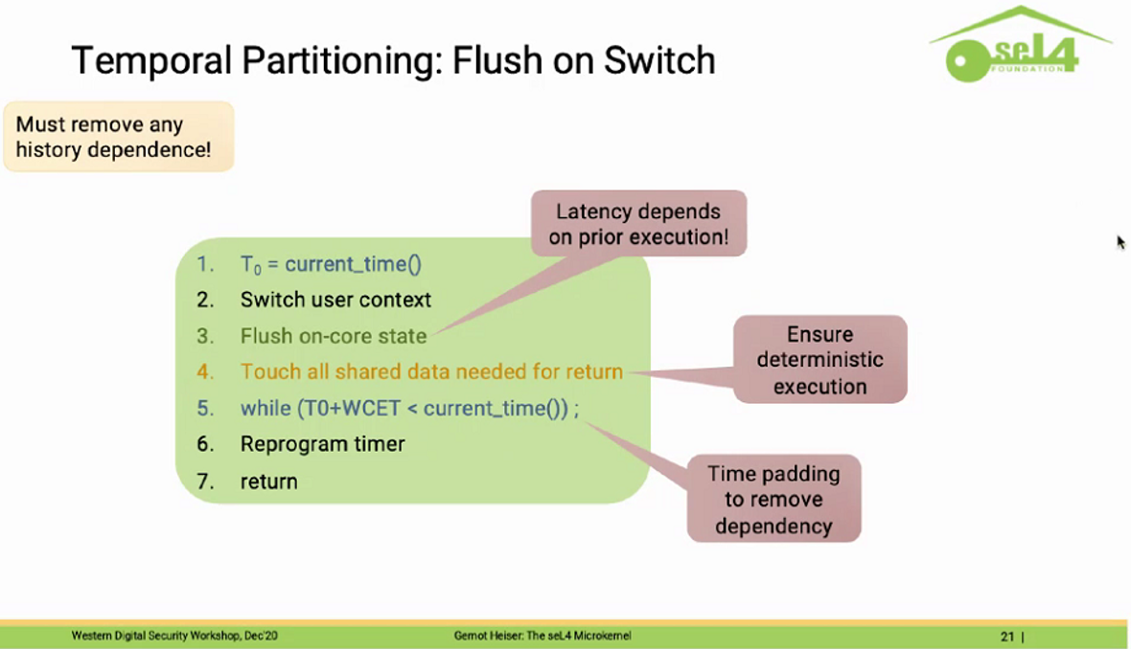
seL4 Context Switch - Stealing Gernot’s slide

Slide 5
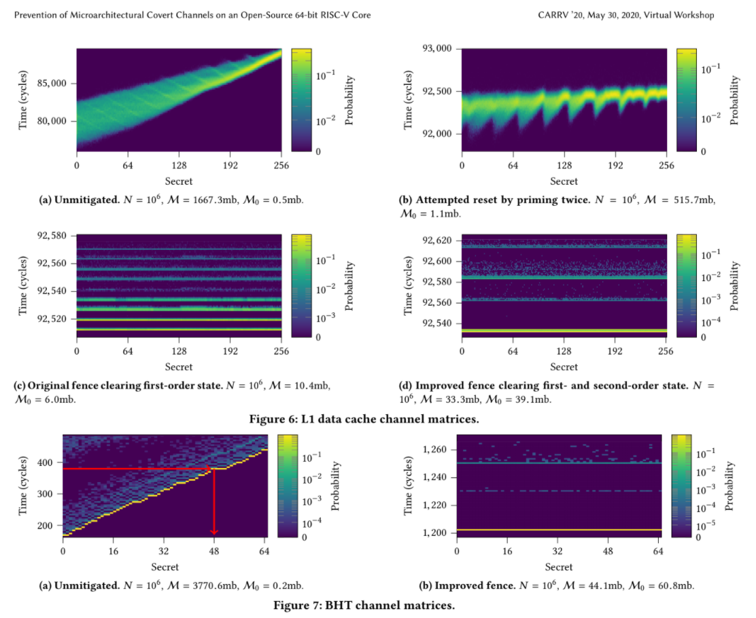
Stealing Some More – Cool Channel Graphs

Slide 6
Expanding – many flushes, what order?
T₀ = current time
Clear WT cache
Switch context
Flush WB cache
Switch context
Flush uarch state
Clear Branch Predictors
L1, L2…
BHT, BTB, Indirect, Return Stack…
Prefetch … ?
wait until T₀ + T_{worst case}
Clear TLB
return (MRET, SRET, …)
Clear HW Prefetchers
IS, D$, L[12…], TLB
see also

Slide 7
Expanding – Deterministic Timing
T₀ = T_{now} current time
loop until end time
leaks information
Switch context
Switch context
Flush uarch state
either ☹
re-flush affected predictors
Prefetch … ?
IMHO ☺
Twait = T₀ + T_{worst case}
PAUSE( T_{wait})
wait until T₀ + T_{worst case}
return (MRET, SRET, …)
but PAUSE( T_{wait}) or PAUSE( T_{abs})
Rejected when Ri5 PAUSE was defined
Time need not be exact, ≥

Slide 8
Best Proposal: PREFETCH(t_{wait} ) or PREFETCH(t_{abs})
IMHO almost a no-brainer
but the security channel may be small
and foolish people may think it unnecessary

Slide 9
Best Proposal: hide FLUSH/CLEAR ugliness
Clear WT cache
x1 ← 0
L: x1 ← SEC.FLUSH.type x1
BNEZ x1
where Implementation determines
which predictors and caches get enumerated for any type of security flush
e.g. “flush everything before partitioned L2”
Flush WB cache
Clear Branch Predictors
L1, L2…
BHT, BTB, Indirect, Return Stack…
Clear TLB
CMOs TG already rejected “address ranges”
These are “microarchitecture ranges”
but SEC.FLUSH nevertheless returns a value
which causes FUD
Clear HW Prefetchers
IS, D$, L[12…], TLB

Slide 10
Hide ugliness: KA & AW’s neat idea
x1 ← 0
L: x1 ← SEC.FLUSH.type x1
BNEZ x1
where Implementation determines
which predictors and caches get enumerated for any type of security flush
e.g. “flush everything before partitioned L2”
Clear WT cache
Flush WB cache
Clear Branch Predictors
L1, L2…
BHT, BTB, Indirect, Return Stack…
Clear TLB
Implementations may
Implement a line at a time
Implement as a state machine
Tap and emulate
lower overhead than per line
easy to extend to “full system”
Use “instant” clears for WT caches, etc
Use different line sizes for different caches
Make strong/weak security guarantees
Can be as secure as possible for Linux
Clear HW Prefetchers
IS, D$, L[12…], TLB

Slide 11
Worst Proposal: Hybrid Mongrel
CPU Internal Stuff
SEC.FLUSH.instant
FOR j FROM 0 to I_size DO
SEC.INVAL.I j
FOR j FROM 0 to Ln_size DO
SEC.FLUSH.Ln j
CPU External Stuff
FOR j FROM 0 to Bus_Bridge_size DO
SEC.FLUSH.MC j
FOR j FROM 0 to MC_size DO
SEC.FLUSH.MC j
Clear WT cache
Flush WB cache
Clear Branch Predictors
L1, L2…
BHT, BTB, Indirect, Return Stack…
Clear TLB
Requires cache + MC Parameter discovery (TBD)
Expensive to trap and emulate
Therefor less likely to be able to handle external caches
Less secure for Standard Linux
Clear HW Prefetchers
IS, D$, L[12…], TLB

Slide 12
Middling Proposal: SBI
Clear WT cache
Implementation dependent SBI call
SBI_call # SEC_FLUSH_type
Flush WB cache
Clear Branch Predictors
L1, L2…
BHT, BTB, Indirect, Return Stack…
Does not add to ISA for such implementation dependent features as caches and predictors.
Clear TLB
Always slow
Clear HW Prefetchers
IS, D$, L[12…], TLB
see Slow Syscalls Considered Dangerous
Impediment to SW portability
somebody has to write the SBI call
Can be as secure as possible for Linux

Slide 13
Conclusion and HELP !!!
The IMHO best proposals
PREFETCH(t)
Hide Ugliness j←SEC.FLUSH.level j
were already rejected by relevant Ri5 TGs
although not for security purposes
The other proposals – Mongrel and SBI – have problems
BKM for as secure as possible involves intermediate cleanup state
OK for Microkernels like seL4, not the way Linux currently does things
Non-causal speculation and fetching
is a real problem cache flushes in general
probably not a real problem for branch predictors
but need a theoretical/abstract model to constrain non-causality
information theoretic?

Slide 14
Real-world microarchitecture considerations

Slide 15

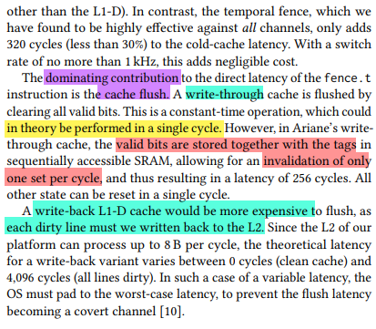
You cannot always instantly flush an array
Anyone with enough experience
has encountered non-WB caches (WT D$, clean only I
that could be instantly cleaned (in some circuit technologies)
but which are not in some implementations
Just recording this evidence for those who have not encountered this.
Also applies to large BTBs and TLBs and any large clean array
links to here

Slide 16
Aside: Noncausal Speculation + Prefetching

Slide 17
Expanding – Accessibility
Secrets
T₀ = T_{now} current time
flushing uarch state
should preventsSpy from observing
secret leakage
Switch context
Switch context
Flush uarch state
WRONG !!!
Prefetch … ?
Noncausal speculation + prefetching
see next slide
wait until T₀ + T_{worst case}
return (MRET, SRET, …)
Spy

Slide 18
Non-causality
naïve: does Flush of uarch state (cache, predictor, etc.)
mean that the next instruction starts with invalid uarch state?
Previous state
WRONG !!!
Flush uarch state
Noncausal speculation + prefetching
see next slide
Next Instruction

Slide 19
Non-causality => Information leaks
naïve: does Flush of uarch state (cache, predictor, etc.)
mean that the next instruction starts with invalid uarch state?
Previous state with Secrets
WRONG !!!
Flush uarch state
Noncausal speculation + prefetching
Noncausal speculation
unlikely - but possible under current abstract model
Previous state with Secrets
may have been reloaded
? come up with a better model ?
Next Instruction
Ri5 noncausal speculation rules fix with break before make

Slide 20
=> Speculation fences don’t work (leakage)
naïve: does Flush of uarch state (cache, predictor, etc.)
mean that the next instruction starts with invalid uarch state?
Previous state with Secrets
WRONG !!!
Speculation Fence
Noncausal speculation + prefetching
Noncausal speculation
Previous state with Secrets
may have been reloaded
Next Instruction

Slide 21
=> Speculation fences don’t work (leakage)
naïve: does Flush of uarch state (cache, predictor, etc.)
mean that the next instruction starts with invalid uarch state?
Previous state with Secrets
WRONG !!!
Flush uarch state
Noncausal speculation + prefetching
Noncausal speculation
Previous state with Secrets
may have been reloaded
Next Instruction

Slide 22
End of Aside: Noncausal Speculation + Prefetching

Slide 23
Expanding – Exfiltration
Secrets
switching context
prevents (privileged)?
context switch code
from speculatively refilling secret leakage after flush
T₀ = T_{now} current time
Switch context
Switch context
Flush uarch state
Noncausal speculation
flushing uarch state
prevents Spy from observing
secret leakage
Prefetch … ?
wait until T₀ + T_{worst case}
return (MRET, SRET, …)
Spy

Slide 24
Expanding – Infiltration and Exfiltration
Target: Secrets
Spy control
– Infiltrating spy
T₀ = T_{now} current time
T₀ = T_{now} current time
Switch context
Switch context
switching context
prevents (privileged)?
context switch code
from speculatively refilling secret leakage after flush
prevents exfiltration
Switch context
switching context
prevents (privileged)?
context switch code
from speculatively refilling secret leakage after flush
=> prevents infiltration
Switch context
Flush uarch state
Flush uarch state
Noncausal speculation
Noncausal speculation
Prefetch … ?
Prefetch … ?
wait until T₀ + T_{worst case}
wait until T₀ + T_{worst case}
return (MRET, SRET, …)
return (MRET, SRET, …)
Spy

Slide 25
Privileged → Unprivileged transition through cleanup state
Secrets
Privileged Domain
with access to secrets
T₀ = T_{now} current time
switching context
prevents (privileged)?
context switch code
from speculatively refilling secret leakage after flush
Switch context
Switch context
Privileged Domain
deliberately removes
its own access to secrets
Flush uarch state
Noncausal speculation
flushing uarch state
prevents Spy from observing
secret leakage
Prefetch … ?
wait until T₀ + T_{worst case}
return (MRET, SRET, …)
Spy
Unprivileged Domain
with access to secrets

Slide 26
Unpriviliged→ Unprivileged transition through cleanup state
User #A Target Secrets
User #A = (un) privilege domain #1
Preemption or Surrender to Runtime
switching context
prevents (privileged)?
context switch code
from speculatively refilling secret leakage after flush
T₀ = T_{now} current time
Privileged Domain #2
deliberately removes
its own access to secrets
Switch context
Flush uarch state
flushing uarch state
prevents Spy from observing
secret leakage
Noncausal speculation
Prefetch … ?
wait until T₀ + T_{worst case}
return (MRET, SRET, …)
User #B Attacker
User #B = (un) privilege domain #3

Slide 27
What is this Intermediate Cleanup State?
Possibilities include
S-mode kernel, but changed page tables
M-mode
ideally some PMPs that M-mode can change
so that these PMPs restrict M-mode (speculation++)

Slide 28
PROBLEM micro kernels may do this Linux does not user usually mapped into kernel top half

Slide 29
Expanding – Infiltration and Exfiltration
Target: Secrets
Spy control
– Infiltrating spy
T₀ = T_{now} current time
T₀ = T_{now} current time
Mitigations?
Forbid speculation across user/kernel boundary
slower system calls
Or.. structure kernel so that secrets are not mapped into top half
i.e. secrets in microkernel kernel processes (not threads),
monolithic kernel for syscalls)
???
Switch USER context (not OS)
Switch context
Flush uarch state
Flush uarch state
Noncausal speculation
Noncausal speculation
Prefetch … ?
Prefetch … ?
wait until T₀ + T_{worst case}
wait until T₀ + T_{worst case}
return (MRET, SRET, …)
return (MRET, SRET, …)
Spy

Slide 30
Slow system calls considered dangerous
when system calls are slow
developers abandon Principle of Least Privilege
(e.g. NT GDI, kernel device drivers)
SBI slide links here

Slide 31
PROBLEM want user → user transitions without syscalls e.g. User level sandboxes in web browsers (assuming syscalls are slow) like Linux, except user cannot manipulate page tables or PMPs

Slide 32
Atomicity and Non-Causal cacheability
The real problem

Slide 33
(Non) Atomicity
WLOG assume: multiple FENCE.T instructions needed at any transition
Wish: PrivDom1 --- FENCE.T ---> PrivDom2
If your hardware can do this, we want the ISA to support it
Probably:
PrivDom1 --- FENCE.bpred.T, FENCE.D$.T ---> PrivDom2
Maybe : PrivDom1 --- FENCE.bpred.T, LOOP { FENCE.T.DS(set.way) } ---> PrivDom2
Abstract: LOOP {FENCE[j].T } for all modules j
merging all the microarchitecture units into the same index space
More than one instruction ➔ atomicity issues
e.g. interrupt in between
block interrupts: unprivileged users cannot… => leads to POLP violations
even guest OSes are users from the point of view of a hypervisor
but it’s not just that…

Slide 34
Speculation ➔ atomicity issues
Even “ideal” has problems: PrivDom1 --- FENCE.T ---> PrivDom2
E.g. returning from syscall
OS-97: … earlier code, may manipulate sensitive data …
OS-98: FENCE.T ideal? … no
OS-99: ERET – return to user mode
USER-100: … user code, which may be attempting to investigate OS state
What can happen between OS-98 and USER-100?
interrupt? - assume OK ( interrupt handler flushes/rekeys)
the real problem is SPECULATION and NON-CAUSAL CACHEABILITY
ANYTHING can happen between OS-98:FENCE.T and OS-99:ERET
as long as it does not affect architectural state, only micro architecture timing state
in the current noncausal cacheability model

Slide 35
Speculation and Non-Causal Cacheabilty
OS-97: … earlier code, may manipulate sensitive data …
OS-98: FENCE.T ideal? … no
OS-99: ERET – return to user mode
USER-100: … user code, which may be attempting to investigate OS state
Q: is cache (and other uarch state) empty/rekeyed between FENCE.T and ERET? A: no…
All that is guaranteed is that the state was flushed/rekeyed during and immediately after FENCE.T … but anything may have been loaded back into the calf and predictors before the ERET. Even if there was no interrupt.
it is correct according to the formal architectural model to instantaneously reload every piece of microarchitectures state that the FENCE.T flushed or rekeyed
Is this likely to happen? No.
But it is allowed to happen in the formal model of speculative behavior
which I defined for P6
which RISC-V has inherited in a slightly modified form
I would like to define a formal model that makes it do what we want.

Slide 36
Why did I do this? (Non-Causal Cacheability)
OS-97: … earlier code, may manipulate sensitive data …
OS-98: FENCE.T ideal? … no
OS-99: ERET – return to user mode
USER-100: … user code, which may be attempting to investigate OS state
There could be a branch prediction made at OS-99 that goes and speculatively re-executes everything that you wanted to flush/rekey.
But… OS-99:ERET is not that sort of branch?
No matter: branch predictions use partial tags
But flushing at least zeroes – so maybe OS-99:ERET will not be predicted as a bad branch alias.
As long as there is no interrupt. (OK, okay…)
Rekeying makes it worse: with the changed key aliasing is increased
Rekeying with a version number
but that’s a timing channel…

Slide 37
Fixed by causality??
OS-97: … earlier code, may manipulate sensitive data …
OS-98: FENCE.T ideal? … no
OS-99: ERET – return to user mode
USER-100: … user code, which may be attempting to investigate OS state
Q: is cache (and other uarch state) empty/rekeyed between FENCE.T and ERET? A: no… how change this answer to yes If we had a formal model for what things you are allowed to do between the OS-98:FENCE.T and OS-99:ERET… i.e. a model of causality?
1991: I gave up on this for Intel P6, in the general case.
Non-causal cacheability: “Anything that is marked cacheable can be placed in the cache at any time”. only the MTRRs constrain. No reasoning about uarch state is guaranteed. It may probably work, but it may not always work.
e.g. can’t trace branches because of partial tagging. Partial instruction caches and partial instruction fetch….
2019: RISC-V = noncausal cacheability
+ “anything that is marked cacheable and is accessible in the present privilege domain can be placed in the cache at any time”. e.g.. Meltdown not allowed, or most Spectre – but samed user level sandbox Spectre still fails. Plus, Ri5 has no MTRRs or dynamic PMAs…
Special cases are possible:
E.g. we could guarantee that the instruction pair OS-98:FENCE.T and OS-99:ERET is fused, nothing happens between them.
CISCy: This is what Intel x86 does for interrupt return CLI;IRET or POPF;IRET
e.g. how to bootstrap un-paged to paged virtual memory (must have identity mapped page…)
Plus, simple pipelines obviously can be reasoned about

Slide 38
fused instruction pair atomicity
E.g. we could guarantee that the instruction pair OS-98:FENCE.T and OS-99:ERET is fused and that nothing happens between them.
This is equivalent to defining a single instruction FENCE.T+ERET, although it might take 64 bits
CISCy: This is what Intel x86 does for interrupt return CLI;IRET or POPF;IRET
RISCy: delayed branches have very similar problem. hence not in Ri5
Ri5: considering doing this in a few places, e.g. NTLH / NTSH - but hints only
Doesn’t help multiple FENCE.T

Slide 39
multi-instruction sequence atomicity
Fusing FENCE.T and ERET doesn’t help when multiple FENCE.T are needed
PrivDom1 --- FENCE.bpred.T, FENCE.D$.T ---> PrivDom2
Maybe : PrivDom1 --- FENCE.bpred.T, LOOP { FENCE.T.DS(set.way) } ---> PrivDom2
Abstract: LOOP {FENCE[j].T } for all modules j
merging all the microarchitecture units into the same index space
Maybe:
OS-97: … earlier code, may manipulate sensitive data …
OS.-98.0: FENCE.T.start -- starts FENCE.T atomic state
OS-98.1: FENCE.bpred.T
OS-98.2: FENCE.D$.T
OS-99: ERET – return to user mode -- implicitly clears the FENCE.T atomic state
USER-100: … user code, which may be attempting to investigate OS state
Allows composition. Adds CSR bit.
Precedent: MIPSr6 LL2/SC2, LLn…SC

Slide 40
multi-instruction sequence constraints
constraints similar to code allowed between LL SC
maximum length?
No loops? … Oops
Lose iteration => no $ flushes
OK: PD1 --- FENCE.T.start, FENCE.bpred.T, FENCE.D$.T,ERET--> PD2
FAIL PD1 --- FENCE.T.start, LOOP { FENCE.T(set/way) }--> PD2
Lose abstraction
OK: PD1 --- FENCE.T.start, FENCE.#1.T, FENCE.#2.T,ERET--> PD2
FAIL: PD1 --- FENCE.T.start, LOOP { FENCE.T.unit[i] }--> PD2

Slide 41
Mode transition to solve atomicity problems
OS-97: … earlier code, may manipulate sensitive data …
OS-98: FENCE.T ideal? … no
OS-99: MCALL – return to M-mode
M-666.1: … set up no access to any OS state
M-666.2: … any instruction sequence you want
implementation specific: FENCE.bpred.T, FENCE.D$.T
abstract: LOOP {FENCE[j].T } for all modules j
M-666.3: MRET
USER-100: … user code, which may be attempting to investigate OS state
This could work. It adds overhead.
Original M mode could not be so restricted, but TEE may allow this.
Or create a new mode. e.g. Jose Renau timing domains….

Slide 42
Wrapping Up
I mainly wanted to show you the problem.
I + Krste + AW have a preferred solution, but the CMO TG already rejected it

Slide 43
my original vision
FENCE.T.target == CMO.SEC.target
flushes or rekeys all uarch timing state between CPU and target
[P,I$) ➔ flush/rekey all bpreds, etc. but not I$
[P,I$] ➔ flush/rekey all bpreds, etc. and I$
[P,D$) ➔ flush/rekey all ALU latency and STLF predictors
[P,D$] ➔ flush/rekey all ALU latency and STLF predictors and D$
[P,L2] ➔ flush all upto L2, including LRU bits…
[P,target) is just a number in the instruction. Not a register operand

Slide 44
implementation possibilities
L: x1 ← 0
x1 ← FENCE.T.target x1
BNEZ x1, L
FENCE.T could be a no-op --- does nothing
FENCE.T could instantaneously clear all uarch timing state
FENCE.T could rekey all uarch timing state
FENCE.T could iterate flushing cache lines…
I thought this was a good idea.
Allow a range of implementations

Slide 45
iterate
L: x1 ← 0
x1 ← FENCE.T.target x1
BNEZ x1, L
unfortunately, X1 is a register, as it must be for (set,way)
all units are placed imnto same index space
e.g 0 = bpred, 1 = BTB, …
FENCE.T takes an index, and writes a new index

Slide 46
CMO TG rejected
actually, they vociferously rejected the “address range” version of this
I wish I had not proposed that first, it wasted so much time
but FENCE.T does not need a virtual address range
it always flushes or re-keys an entire uarch structure, cache or predictor
or possibly a partition, e.g. way locking
CMO TG phase 1 is doing only single address,
could not reach agreement on whole cache
not “whole cache” - CMO.UR.ALL, sync/async
not CMO.UR.IX (set,way)
phase 2 may look like CMO.SEC.UR == FENCE.T.target
but I doubt it, I am so shellshocked
worth thinking about possible objections
risk: CMO TG pissed off by the FENCE.T.target proposed here

Slide 47
Summary
rekeying is not a silver bullet
but it’s good when you can do it
flushing necessary for things like writeback caches
if Spectre/Meltdown important, more instantaneous writethrough flushes
IMHO single operation bad
certainly fails external, but even inside CPU has problems
single instruction bad - RISC
multiple instructions or iteration - good, if accepted
real problems are atomicity and noncausal cacheability
fuse FENCE.T;ERET
multi-instruction sequence FENCE.T.start, FENCE.T.#1, FENCE.T.#2, ERET
transition through mode
E.g. M-mode SBI (slow, minor changes to an mode needed like TEE)
E.g. Jose Renau lightweight timing domains
KA/AW/Ag: FENCE.T.target Rsrcsdt
Solves all the problems I know about
but CMO TG … rejected address range, and hasn’t had time to really look at security-related flushes and (set,way)

Slide 48
BACKGROUND

Slide 49
Security (Inference Channel) CMO/Flushes
CMO.UR.SEC*.$id rs1/rd
rs2=x0. s1/rd is srcdst, containing “abstract cache index”, like other CMO.UR
?? rs2 != x0: CMO.UR.SEC*.$id rs1/rd, rs2:WordGuard_or_other_ID
TBD: need a CSR to avoid virtualization hole (Contentious).
CMO.UR.SEC.I
clear I$, all branch predictors, etc
CMO.UR.SEC.D
flush L1 D$, STLF, cache miss predictor, way predictor, etc.
CMO.UR.SEC.ID
I + D.
Typically a full CPU/processor
CMO.UR.SEC.POC_P
flush to point of coherence of all processors – included LRU, prefetchers, etc.
Typically L2, MLC or LLC depending
CMO.UR.SEC.POC_P_IO
flush to point of coherence of all processors and IO
typically DRAM (but not always)
DRAM open/close page predictors?
CMO.UR.SEC.MAX
maximal (standard) flush.
maybe same as POC_P or POC_P_IO
Most security related flushes are “whole cache” => CMO.UR
TBD: by address flushes CMO.64B.SEC and CMO.AR.SEC maybe – e.g. flus just security LUTs and key dependent data structures
All writeback dirty data, and leave all invalid
In addition, reset/invalidate all uarch perf related state up to specified point => CMO.UR.SEC.*
Branch predictors, prefetchers, store to load forwarding predictors, LRU, way predictors
Note: such flushes are often idiosyncratic – few busses have good support (although, e.g. AERM DVM has fgush bpred)
Implementations will take advantage when standard bus support exits.
Implementation can trap to M-mode if “mash-up” SOC has support, but not standard on bus. CMO.UR => amortize such trap overhead
OVERALL: the RISC-V CMO.UR proposal will encourage SOC/NOC IP,to improve support, while supporting legacy
NOTE: most predict state is not coherent => may need to perform CMO.SEC.* on all CPUs involved
“Abstract cache index” = shows benefit of CMO.UR approach. Not just (set,way) iof a single cache, but may include flash resets or iteration over branch predictors, etc.
i.e. the abstract cache index is not just for a single HW cache array
CMO.UR can solve atomicity issues: e.g. flush bpred before I$, or after – neither is good enough
Levels:
Security would like to flush everything – up to point where cache is physically partitioned.
But security/perf tradeoff – e.g. we browser may flush as much as it can flush without making page too slow. Hence levels here.
Expect more levels in a system dependent manner. TBD CSRs?
User code friendly (including thread migration):
e.g. Web browsers want to flush uarch state on transitions between JavaScript in sandbox and user level runtime - without system call overhead
Delegation => OS can allow or disallow, depending on security model
CMO.UR.* form can be process/thread migration compatible
embedded/HPC – often no process/thread migration
general-purpose Oss - usually do process/thread migration
e.g. CMO.UR.SEC.{ID,POC__*,MAX} are migration safe if traversing a strictly inclusive chared ache level
trap/delegate if not inclusive
CMO.UR.SEC* stylized code => cO/VMM context switch code can detect and complete or delay migration
virtual machines => migration even though OS thinks fixed CPU
Full disclosure: proposed
but contentious.
if CMO.UR rejected, will have more distinct instructions (and IMHO less security, no user mode, etc.)
Caveat: ISA supports good inference channel control
but uarch may have incomplete support.
TBD: how document what implementation provides. NOTE: CMO.UR.SEC.* supports efficient trap to fix problems discovered once deployed.

Slide 50
Security (channel) TLB flushes
RISC-V original
sfence.vma - local TLB flushes,
by virtual address, by ASID, all…
constant time and other security-related properties not defined, but that would not be hard
I had hoped to address this in the CMO TG, but the CMO TG is bogged down doing non-coherent I/O
AFAIK no RISC-V group has worked on “TLB shoot down” instructions
not the virtual memory group, not the CMOs group
resistance (AW) to requiring ASID constant
but ARM and Intel and many others have such instructions
Obvious extension to already proposed CMO.UR.SEC.*

Slide 51
FLUSH – or NOT
Let’s get this out of the way:
Strict partitioning in space and time flushing is not the only way some systems have proposed to mitigate covert/ leak channels.
E.g. some change hash keys.
This is great, if it is good enough. But it is not always good enough.
links here

Slide 52
Flush – or NOT – ?
Let’s get this out of the way:
Gernot: partition in time or partition in space …
Partition in time:
I hope we agree that flushing microarchitecture data structures - clearing them zeroing them - on transitions between privilege domains is sufficient
What about non-strict partitioning?
e.g. instead of flushing if time sharing
e.g. instead of strictly partitioning if space sharing
encrypt or hash the microarchitecture state
changing keys between privilege domains
WLOG I want to call this “keying microarchitecture state

Slide 53
Keying microarchitecture state
BRIEF: this is a great idea, but it has limitations
I want to allow, implementations, e.g. if you want to make your FENCE.T fast
but I don’t want to assume that all implementations will do this
i.e. I do not want the ISA to make assumptions that work for keying but not for flushing or strict partitioning
Implementations that care about security should document the timing channel parameters and properties
just like we used to do for Orange Book in 1980s
if keying the microarchitecture state is good enough, great
if not, …

Slide 54
Why (not) keying ? E.g. QCOM - branch predictor - change hash on context switches
Maybe OK for information leaks
attacker does not know mappings
e.g. of branch addresses (and histories) to branch predictor entries
neither for victim nor attacker
note: also need to hash prediction taken/not-taken…
makes it hard to target particular branches as in Spectre/Meltdown
But covert channel still exists
Cooperating bad guys A+B can signal each other by
estimate size of branch predictor - occupying all entries
A fills with highly biased branches
B signals
0: does nothing
1: fills with highly biased branches
A re-measures
no change: B signalled 0
change >~50%: B signalled 1
Turns: time?
It is not a great covert channel,
not as high bandwidth as some,
but nevertheless…

Slide 55
Covert versus Information Leak channels
The covert channel described in previous slide maybe not high-bandwidth.
Covert: cooperating bad guys A+B in different privilege domains
It may be hard to use this as an information leak channel
Leak: attacker A and victim V in different privilege domains
… hard / very hard / may be impossible, but I doubt it lacking a formal proo
STRONG PROPERTY: if there is no covert channel, then there can be no information leak
BESIDES: victim behavior in many places is a well-known. amounts to a stupid bad guy B.

Slide 56
FLUSH – or NOT
Strict partitioning in space and time flushing is not the only way some systems have proposed to mitigate covert/ leak channels.
E.g. some change hash keys.
This is great, if it is good enough. But it is not always good enough.
I want a FENCE.T ISA that can do both time and key partitioning
And I want the user not have to care about he actual implementation
Clumsy terminology:
partitioning in time: “flushing””
strict partitioning in space …
partitioning fiat key/hashing
non-strict in time: change key on context switch without flushing
non-strict in space: different keys for users sharing/overlapping same data structure
I wish I had a word that covered both explicit flushing and changing keys. Since I don’t know if such a word, I will say “flushing” to include both

Slide 57
Flushing uarch state
and/or key switching…

Slide 58
Lots of uarch timing state
Examples:
Ifetch: next cache line predictor, conditional, branch location (BTB), return stack, fast L1/slower L2, …; predecode bits in L2$ …
Decoder: branch location known, => larger
Data memory: load latency predictor, STLF predictor
D$ (L1,L2,L3…) way predictor, LRU, bank conflict predictor…
Prefetchers – in CPU, and external
DRAM page open policy prediction
ALU latency predictor ( multiply, divide, memorization)
Power predictor: powerdown/retain parts of chip
TBD: diagram: essentially at any point where there’s an arrow between two blocks, there can be a predictor.

Slide 59
Some uarch state easy to flush (or key)
E.g. “instantaneous block clear” of valid bits…
but… one of the first things I learned as a young computer architect
is that not all technology can do instantaneous block clear
4 sets of valid bits, switch, state machine clears in background… TC still exists

Slide 60
Sometimes flushing/rekeying hurts performance
Sometimes big performance benefit for sharing (not flushing/keying)
e.g. 2 different user processes accessing similar webpages or databases
e.g. user may train OS predictors and vice versa
OS read() syscall may load cache values that user wants to use
It’s my fault:
I deliberately decided not to flush branch predictors on OS/user transitions in 1991 for Intel P6
why not? -- Gould secure UNIX experience. Performance.
if you lose performance by partitioning into different privilege domains, users will put things that should be in different privilege domains in the same, violating Principle of Least Privilege.
e.g. Microsoft NT GDI - originally in kernel, moved to user mode because kernel crossings too slow
Which is more important?: POLP or TC ? A: both?
IMHO: let system software decide when it wants to flush and when it doesn’t
conservative: flush/rekey on all privilege domain crossings
stupid and insecure: never flush (pre-Spectre)
smarter:
different processes same user ➔ may be don’t need to flush
user/top-half OS ➔ don’t flush if no sensitive info
flush if sensitive info
hard: same process same user different privilege??

Slide 61
Some uarch state hard to flush (or key)
Semantics
Some uarch state cannot be instantaneously flushed
e.g. dirty cache lines ➔ must be written out one by one
shared memory locations ➔ cannot change keys for dirty data
Physics
Some uarch data structures are just plain too big… must iterate
over entries, sets, ways, banks…
Modularity
Different functional units may have different keying operations and instructions
may not be possible to put in a single instruction
maybe not FENCE.T
but FENCE.bpred.T, FENCE.D$.T
abstract: LOOP {FENCE[i].T } for all modules i
even if same instruction, may not occur at the same stage of pipeline
Can’t even stall pipelines anymore (HF) – replay buffers
Physics + Modularity
+ … Formal Speculation Model …
➔ Atomicity problems
this is my biggest concern

